Slide 1

AI and Covid
Prof. Dr. Maria A. Wimmer, wimmer@uni-koblenz.de
Vera Spitzer, vesp91@uni-koblenz.de
http://www.uni-koblenz.de/agvinf/
SoSe 2022

Slide 2
Team Members:
Irshad Hussain Mohammed
Manpreeth Vankadara
Nirav Satani
Pavan Kumar Tokachichu
Pavan Kumar Reddy Kancharla
Peram Navachandu Reddy
Ramesh Reddy Modulla
Rehan Ali Syed
Sudheer Kumar Gandham
Venkata Satya Aditya Jagarlapudi

Slide 3
COVID-19 based Incidence Response Model

Slide 4
Agenda:
Detailed Architecture of Project
Data Acquisition
Data Preparation
Data Analysis Algorithms
Data Visualisation Tools

Slide 5
Architecture:
Data Acquisition
Data Preparation
Identifying countries
Data Analysis using Time Series Analysis
Evaluation on Covid Data
Data Visualization

Slide 6
Data Acquisition
Most of the countries allow tracking of flights to other countries using the ADSB method to track flight.
Chinese government has a ban on these kind of tracking methods. We have to find other sources for flights to and from China
Reference: https://news.ycombinator.com/item?id=29150953
Data Link from 2019 to 2022(March) are available as CSV files.
https://zenodo.org/record/6411336
Most of the websites have subscription plans.Some of the websites are below.
https://uk.flightaware.com/commercial/aeroapi/
https://aviationstack.com/product
Data Simulation Method is being researched

Slide 7
Data Preparation
1. For Getting the number of passengers:
i. Identify the aircraft model and get the seating capacity
ii. Averaging of the incoming passengers of a country
2.Removing null values
3.Dealing with Missing Data
4.Grouping Data

Slide 8
Data Analysis Algorithms
ARIMA - Auto Regressive Integrated Moving Average
Vector Auto Regression
GARCH
Exponential Smoothing
LTSM - Long Term Short Memory
DeepAR

Slide 9
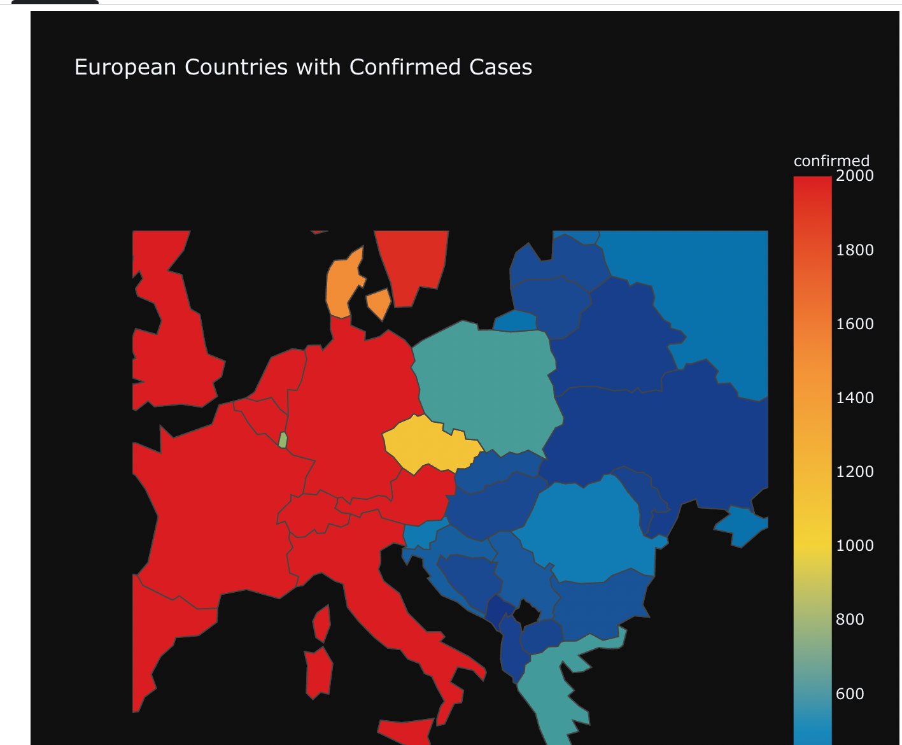
Data Visualisation Tools
Tableau for visualisation
Final Deliverable Product
Notes:
Reference: https://www.kaggle.com/code/abhinand05/covid-19-digging-a-bit-deeper

Slide 10
Thank You

